Slide 1


Protection of tables at an overall level Recap – and more about hierarchies
SDC Course 2025
Øyvind Langsrud

Slide 2
Hierarchies

Slide 3
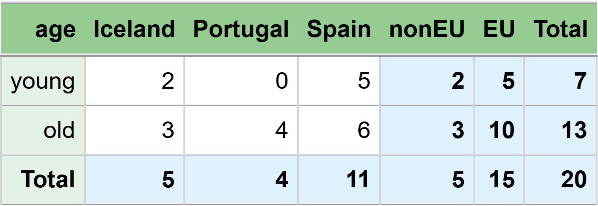
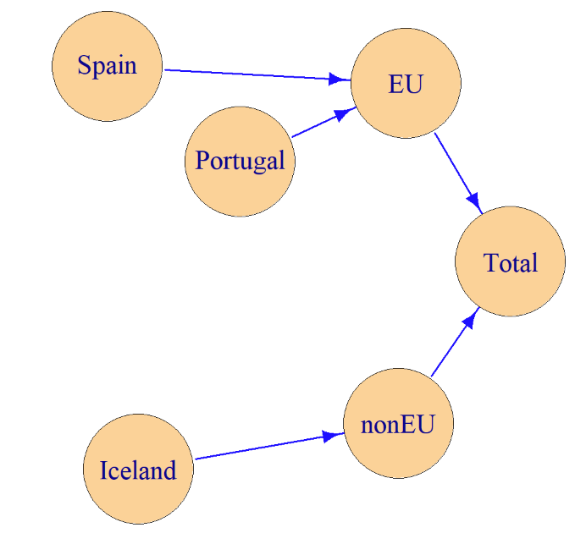
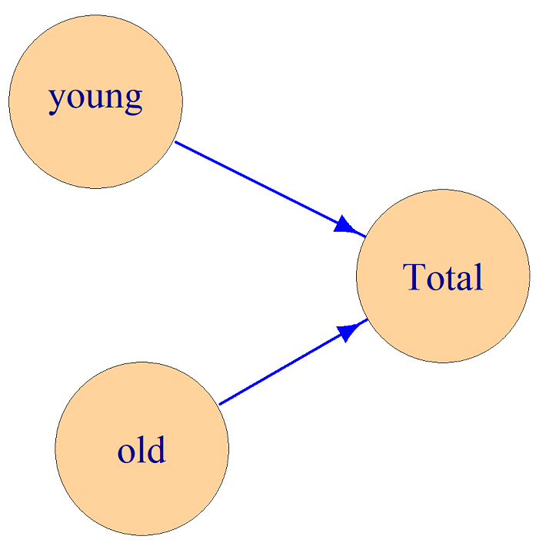
Hierarchies

Slide 4
Hierarchies
age geo freq
1 Total Total 20
2 Total EU 15
3 Total nonEU 5
4 Total Iceland 5
5 Total Portugal 4
6 Total Spain 11
7 old Total 13
8 old EU 10
9 old nonEU 3
10 old Iceland 3
11 old Portugal 4
12 old Spain 6
13 young Total 7
14 young EU 5
15 young nonEU 2
16 young Iceland 2
17 young Portugal 0
18 young Spain 5

Slide 5
All of these specifications can be used as input in the R package GaussSuppression
Total
├─EU
│ ├─Portugal
│ └─Spain
└─nonEU
└─Iceland
levels codes
@ Total
@@ EU
@@@ Portugal
@@@ Spain
@@ nonEU
@@@ Iceland
from to
EU Total
Portugal EU
Spain EU
nonEU Total
Iceland nonEU
Total = EU + nonEU
EU = Portugal + Spain
nonEU = Iceland
"EU" "@Portugal" "@Spain" "nonEU" "@Iceland"

Slide 6
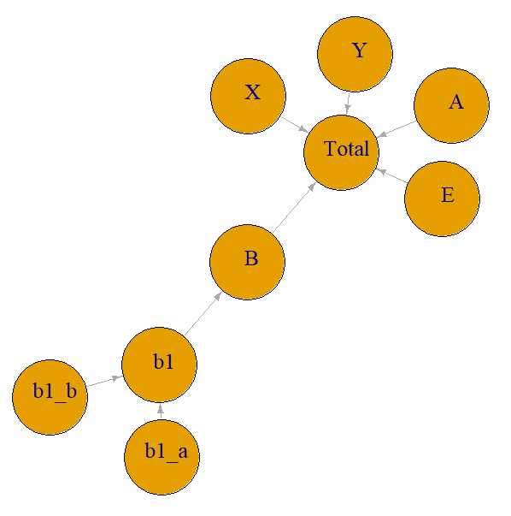
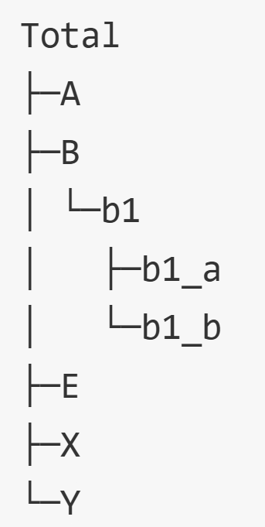
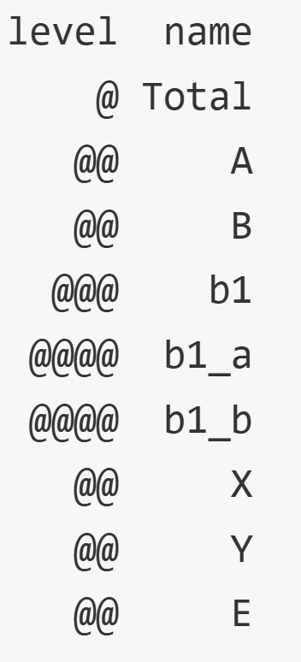

Slide 7
age geo freq
1 Total Total 40
2 Total B 9
3 Total b1 9
4 Total A 11
5 Total E 11
6 Total X 5
7 Total Y 4
8 Total b1_a 5
9 Total b1_b 4
10 old Total 26
11 old B 7
12 old b1 7
13 old A 6
14 old E 6
15 old X 3
16 old Y 4
17 old b1_a 3
18 old b1_b 4
19 young Total 14
20 young B 2
21 young b1 2
22 young A 5
23 young E 5
24 young X 2
25 young Y 0
26 young b1_a 2
27 young b1_b 0
age geo freq
1 young A 5
2 young X 2
3 young Y 0
4 young E 5
5 young b1_a 2
6 young b1_b 0
7 old A 6
8 old X 3
9 old Y 4
10 old E 6
11 old b1_a 3
12 old b1_b 4
But only the most detailed codes in the input
Here all codes are included in the output

Slide 8
age geo eu freq
1 young Spain EU 5
2 young Iceland nonEU 2
3 young Portugal EU 0
4 old Spain EU 6
5 old Iceland nonEU 3
6 old Portugal EU 4
age geo freq
1 Total Total 20
2 Total EU 15
3 Total nonEU 5
4 Total Iceland 5
5 Total Portugal 4
6 Total Spain 11
7 old Total 13
8 old EU 10
9 old nonEU 3
10 old Iceland 3
11 old Portugal 4
12 old Spain 6
13 young Total 7
14 young EU 5
15 young nonEU 2
16 young Iceland 2
17 young Portugal 0
18 young Spain 5
Total
├─EU
│ ├─Portugal
│ └─Spain
└─nonEU
└─Iceland
Here all codes, except Total, can be seen in the input
Again, all codes are included in the output

Slide 9
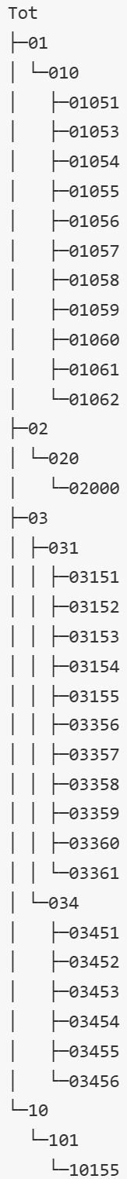
NACE coding at different digit levels
NACE coding classifies businesses by their economic activities using standardized EU codes.

Slide 10
NACE coding at different digit levels
These two examples are taken from the vignette of the R-package called
sdcHierarchies

Slide 11
Hierarchies
A complicating factor in table production
Suppression
Methods must take all hierarchical relationships into account
Perturbation
Unproblematic for some methods
The Cell Key Method can treat one table cell at a time
More challenging for others
Small Count Rounding should consider all outputs simultaneously to achieve the best possible result

Slide 12
Sensitive cells

Slide 13
Disclosure is possible – When sensitive cells are published
Avoiding disclosure risk
– Don’t publish sensitive cells
Sensitive cells:
Frequency tables: 0s, 1s, or small counts
Magnitude tables: few contributors or one/two dominant ones

Slide 14
 | Europe | America | Rest of World | Total world
Christmas gifts | IKEA = 1.7 Nike = 13.1 Tesla = 1.8 k1 = 78.9%, k2 = 89.8% p = 13.0% | IKEA = 3.4 Nike = 50.2 Pepsi = 9.1 Sony = 63.8 k1 = 50.4%, k2 = 90.1% p = 19.6% | Nike = 43.2 Pepsi = 105.3 Sony = 96.6 Tesla = 8.4 k1 = 41.5%, k2 = 79.6% p = 49.0% | IKEA = 5.1 Nike = 106.5 Pepsi = 114.4 Sony = 160.4 Tesla = 10.2 k1 = 40.4%, k2 = 69.3% p = 75.9%
Other gifts | Nike = 16.8 Pepsi = 10.4 Tesla = 8.7 k1 = 46.8%, k2 = 75.8% p = 51.8% | IKEA = 26.0 Nike = 21.6 Pepsi = 36.9 k1 = 43.7%, k2 = 74.4% p = 58.5% | IKEA = 2.7 Tesla = 6.5 k1 = 70.7%, k2 = 100.0% p = 0.0% | IKEA = 28.7 Nike = 38.4 Pepsi = 47.3 Tesla = 15.2 k1 = 36.5%, k2 = 66.1% p = 92.8%
Total gifts | IKEA = 1.7 Nike = 29.9 Pepsi = 10.4 Tesla = 10.5 k1 = 57.0%, k2 = 77.0% p = 40.5% | IKEA = 29.4 Nike = 71.8 Pepsi = 46.0 Sony = 63.8 k1 = 34.0%, k2 = 64.3% p = 105.0% | IKEA = 2.7 Nike = 43.2 Pepsi = 105.3 Sony = 96.6 Tesla = 14.9 k1 = 40.1%, k2 = 76.9% p = 57.7% | IKEA = 33.8 Nike = 144.9 Pepsi = 161.7 Sony = 160.4 Tesla = 25.4 k1 = 30.7%, k2 = 61.2% p = 126.2%
Dominance rules:
Compute the percentage contribution of the largest contributor
Compute the combined percentage contribution of the two largest contributors
To identify sensitive cells, one must examine each contributor’s value within each table cell.

Slide 15
 | Europe | America | Rest of World | Total world
Christmas gifts | IKEA = 1.7 Nike = 13.1 Tesla = 1.8 k1 = 78.9%, k2 = 89.8% p = 13.0% | IKEA = 3.4 Nike = 50.2 Pepsi = 9.1 Sony = 63.8 k1 = 50.4%, k2 = 90.1% p = 19.6% | Nike = 43.2 Pepsi = 105.3 Sony = 96.6 Tesla = 8.4 k1 = 41.5%, k2 = 79.6% p = 49.0% | IKEA = 5.1 Nike = 106.5 Pepsi = 114.4 Sony = 160.4 Tesla = 10.2 k1 = 40.4%, k2 = 69.3% p = 75.9%
Other gifts | Nike = 16.8 Pepsi = 10.4 Tesla = 8.7 k1 = 46.8%, k2 = 75.8% p = 51.8% | IKEA = 26.0 Nike = 21.6 Pepsi = 36.9 k1 = 43.7%, k2 = 74.4% p = 58.5% | IKEA = 2.7 Tesla = 6.5 k1 = 70.7%, k2 = 100.0% p = 0.0% | IKEA = 28.7 Nike = 38.4 Pepsi = 47.3 Tesla = 15.2 k1 = 36.5%, k2 = 66.1% p = 92.8%
Total gifts | IKEA = 1.7 Nike = 29.9 Pepsi = 10.4 Tesla = 10.5 k1 = 57.0%, k2 = 77.0% p = 40.5% | IKEA = 29.4 Nike = 71.8 Pepsi = 46.0 Sony = 63.8 k1 = 34.0%, k2 = 64.3% p = 105.0% | IKEA = 2.7 Nike = 43.2 Pepsi = 105.3 Sony = 96.6 Tesla = 14.9 k1 = 40.1%, k2 = 76.9% p = 57.7% | IKEA = 33.8 Nike = 144.9 Pepsi = 161.7 Sony = 160.4 Tesla = 25.4 k1 = 30.7%, k2 = 61.2% p = 126.2%
Dominance rules:
Compute the percentage contribution of the largest contributor
Compute the combined percentage contribution of the two largest contributors
Find the sensitive cells
Cells where the chosen threshold values ​​are exceeded
With 90% as k2-limit. This cell is primary suppressed.
And of course this cell is is primary suppressed.

Slide 16
 | Europe | America | Rest of World | Total world
Christmas gifts | IKEA = 1.7 Nike = 13.1 Tesla = 1.8 k1 = 78.9%, k2 = 89.8% p = 13.0% | IKEA = 3.4 Nike = 50.2 Pepsi = 9.1 Sony = 63.8 k1 = 50.4%, k2 = 90.1% p = 19.6% | Nike = 43.2 Pepsi = 105.3 Sony = 96.6 Tesla = 8.4 k1 = 41.5%, k2 = 79.6% p = 49.0% | IKEA = 5.1 Nike = 106.5 Pepsi = 114.4 Sony = 160.4 Tesla = 10.2 k1 = 40.4%, k2 = 69.3% p = 75.9%
Other gifts | Nike = 16.8 Pepsi = 10.4 Tesla = 8.7 k1 = 46.8%, k2 = 75.8% p = 51.8% | IKEA = 26.0 Nike = 21.6 Pepsi = 36.9 k1 = 43.7%, k2 = 74.4% p = 58.5% | IKEA = 2.7 Tesla = 6.5 k1 = 70.7%, k2 = 100.0% p = 0.0% | IKEA = 28.7 Nike = 38.4 Pepsi = 47.3 Tesla = 15.2 k1 = 36.5%, k2 = 66.1% p = 92.8%
Total gifts | IKEA = 1.7 Nike = 29.9 Pepsi = 10.4 Tesla = 10.5 k1 = 57.0%, k2 = 77.0% p = 40.5% | IKEA = 29.4 Nike = 71.8 Pepsi = 46.0 Sony = 63.8 k1 = 34.0%, k2 = 64.3% p = 105.0% | IKEA = 2.7 Nike = 43.2 Pepsi = 105.3 Sony = 96.6 Tesla = 14.9 k1 = 40.1%, k2 = 76.9% p = 57.7% | IKEA = 33.8 Nike = 144.9 Pepsi = 161.7 Sony = 160.4 Tesla = 25.4 k1 = 30.7%, k2 = 61.2% p = 126.2%
p% rule:
Determine how closely (in percentage terms) the second-largest contributor can estimate the value of the largest contributor

Slide 17
 | Europe | America | Rest of World | Total world
Christmas gifts | IKEA = 1.7 Nike = 13.1 Tesla = 1.8 k1 = 78.9%, k2 = 89.8% p = 13.0% | IKEA = 3.4 Nike = 50.2 Pepsi = 9.1 Sony = 63.8 k1 = 50.4%, k2 = 90.1% p = 19.6% | Nike = 43.2 Pepsi = 105.3 Sony = 96.6 Tesla = 8.4 k1 = 41.5%, k2 = 79.6% p = 49.0% | IKEA = 5.1 Nike = 106.5 Pepsi = 114.4 Sony = 160.4 Tesla = 10.2 k1 = 40.4%, k2 = 69.3% p = 75.9%
Other gifts | Nike = 16.8 Pepsi = 10.4 Tesla = 8.7 k1 = 46.8%, k2 = 75.8% p = 51.8% | IKEA = 26.0 Nike = 21.6 Pepsi = 36.9 k1 = 43.7%, k2 = 74.4% p = 58.5% | IKEA = 2.7 Tesla = 6.5 k1 = 70.7%, k2 = 100.0% p = 0.0% | IKEA = 28.7 Nike = 38.4 Pepsi = 47.3 Tesla = 15.2 k1 = 36.5%, k2 = 66.1% p = 92.8%
Total gifts | IKEA = 1.7 Nike = 29.9 Pepsi = 10.4 Tesla = 10.5 k1 = 57.0%, k2 = 77.0% p = 40.5% | IKEA = 29.4 Nike = 71.8 Pepsi = 46.0 Sony = 63.8 k1 = 34.0%, k2 = 64.3% p = 105.0% | IKEA = 2.7 Nike = 43.2 Pepsi = 105.3 Sony = 96.6 Tesla = 14.9 k1 = 40.1%, k2 = 76.9% p = 57.7% | IKEA = 33.8 Nike = 144.9 Pepsi = 161.7 Sony = 160.4 Tesla = 25.4 k1 = 30.7%, k2 = 61.2% p = 126.2%
p% rule:
Determine how closely (in percentage terms) the second-largest contributor can estimate the value of the largest contributor
With 15% as p-limit. This cell is primary suppressed.
And of course this cell is is primary suppressed.

Slide 18
 | Europe | America | Rest of World | Total world
Christmas gifts | 16.6 | 126.5 | 253.5 | 396.6
Other gifts | 35.9 | 84.5 | 9.2 | 129.6
Total gifts | 52.5 | 211.0 | 262.7 | 526.2
16.6
9.2

Slide 19


Secondary Suppression

Slide 20
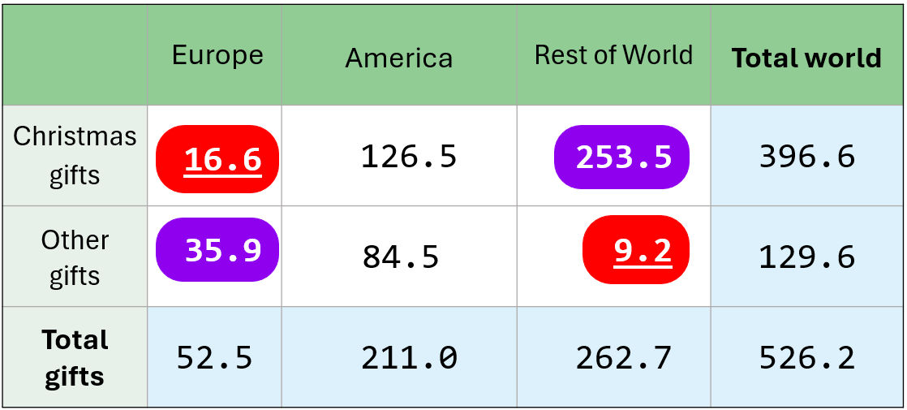
 | Europe | America | Rest of World | Total world
Christmas gifts | 16.6 | 126.5 | 253.5 | 396.6
Other gifts | 35.9 | 84.5 | 9.2 | 129.6
Total gifts | 52.5 | 211.0 | 262.7 | 526.2
16.6
253.5
35.9
9.2

Slide 21
gifts world_region value primary suppressed
1 Total Total 526.2 FALSE FALSE
2 Total America 211.0 FALSE FALSE
3 Total Europe 52.5 FALSE FALSE
4 Total Rest of World 262.7 FALSE FALSE
5 Christmas Total 396.6 FALSE FALSE
6 Christmas America 126.5 FALSE FALSE
7 Christmas Europe 16.6 TRUE TRUE
8 Christmas Rest of World 253.5 FALSE TRUE
9 Other Total 129.6 FALSE FALSE
10 Other America 84.5 FALSE FALSE
11 Other Europe 35.9 FALSE TRUE
12 Other Rest of World 9.2 TRUE TRUE

Slide 22
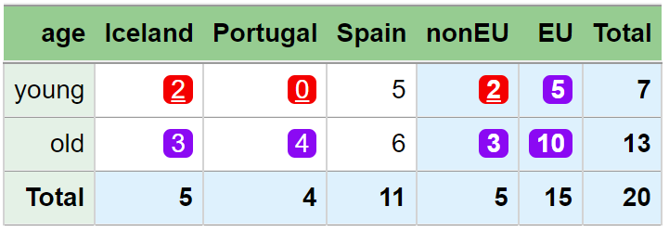
age geo freq primary suppressed
1 Total Total 20 FALSE FALSE
2 Total EU 15 FALSE FALSE
3 Total nonEU 5 FALSE FALSE
4 Total Iceland 5 FALSE FALSE
5 Total Portugal 4 FALSE FALSE
6 Total Spain 11 FALSE FALSE
7 old Total 13 FALSE FALSE
8 old EU 10 FALSE TRUE
9 old nonEU 3 FALSE TRUE
10 old Iceland 3 FALSE TRUE
11 old Portugal 4 FALSE TRUE
12 old Spain 6 FALSE FALSE
13 young Total 7 FALSE FALSE
14 young EU 5 FALSE TRUE
15 young nonEU 2 TRUE TRUE
16 young Iceland 2 TRUE TRUE
17 young Portugal 0 TRUE TRUE
18 young Spain 5 FALSE FALSE

Slide 23
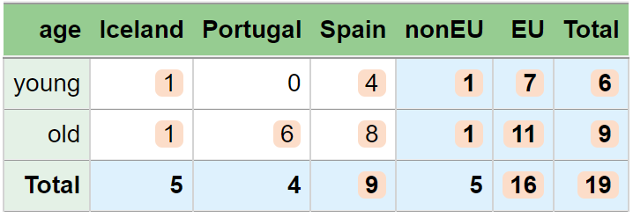
Perturbation

Slide 24
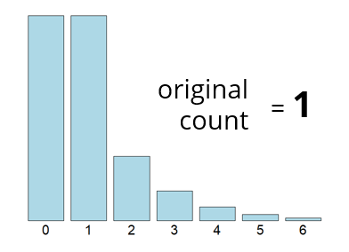
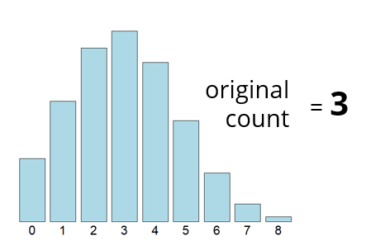
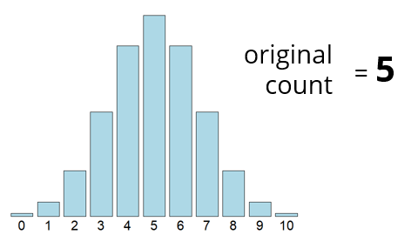
Cell Key Method
age geo original perturbed
1 Total Total 20 19
2 old Total 13 9
3 young Total 7 6
4 Total Iceland 5 5
5 Total Portugal 4 4
6 Total Spain 11 9
7 Total EU 15 16
8 Total nonEU 5 5
9 old Iceland 3 1
10 old Portugal 4 6
11 old Spain 6 8
12 young Iceland 2 1
13 young Portugal 0 0
14 young Spain 5 4
15 old EU 10 11
16 old nonEU 3 1
17 young EU 5 7
18 young nonEU 2 1

Slide 25
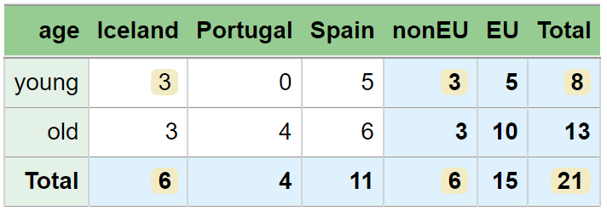
Small Count Rounding
age geo original rounded
1 Total Total 20 21
2 old Total 13 13
3 young Total 7 8
4 Total Iceland 5 6
5 Total Portugal 4 4
6 Total Spain 11 11
7 Total EU 15 15
8 Total nonEU 5 6
9 old Iceland 3 3
10 old Portugal 4 4
11 old Spain 6 6
12 young Iceland 2 3
13 young Portugal 0 0
14 young Spain 5 5
15 old EU 10 10
16 old nonEU 3 3
17 young EU 5 5
18 young nonEU 2 3
age geo original rounded
1 young Spain 5 5
2 young Iceland 2 3
3 young Portugal 0 0
4 old Spain 6 6
5 old Iceland 3 3
6 old Portugal 4 4

Slide 26
Sensitive cells in frequency tables

Slide 27
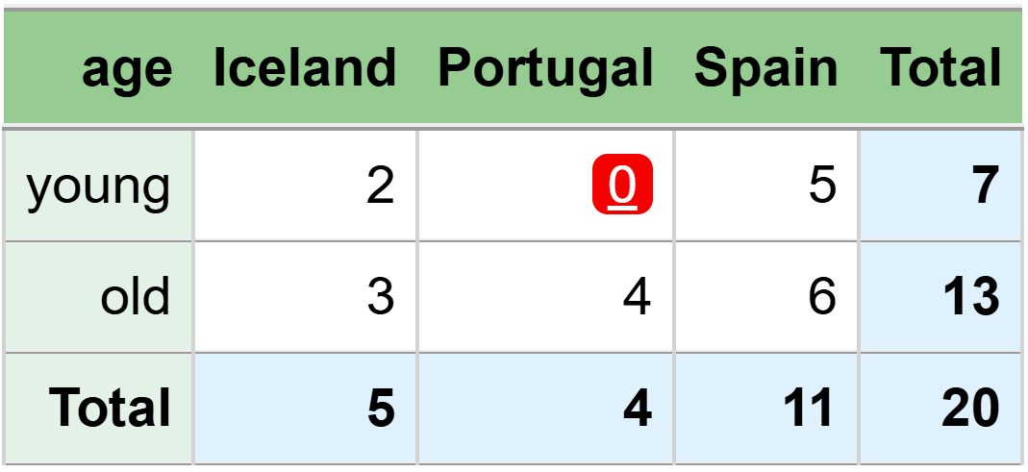
0 as sensitive
Known that country is Portugal → Disclose that age is old
Known that age is young → Disclose that country is not Portugal

Slide 28
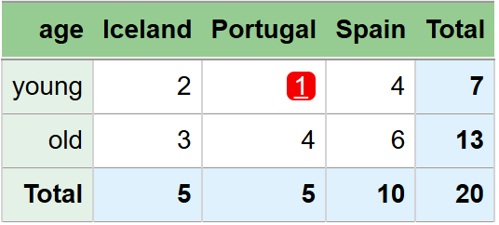
Known that country is Portugal → Disclose that age is old
Known that age is young → Disclose that country is not Portugal
1 as sensitive
The person from Portugal who is young can make the same disclosure

Slide 29

Known that country is Portugal → Disclose that age is old
Known that age is young → Disclose that country is not Portugal
2 as sensitive
The 2 persons from Portugal who are young can, as a group, make the same disclosure

Slide 30
Intervals

Slide 31
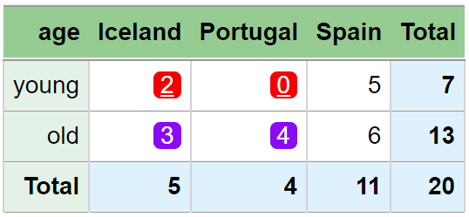
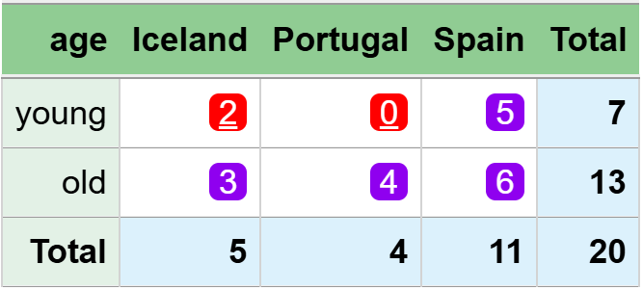
The two young individuals from Iceland, as a group, can disclose that all other young individuals are from Spain.
This is also the case after suppression.
Primary cells are protected
In the sense that their exact values cannot be recalculated
But intervals can still be derived
In this example, both primary cells end up with the interval:
[0, 2]
Is that acceptable?
No, not when you consider the rationale behind the primary suppression.
A solution is to set requirements for the intervals
It can be done in Tau-Argus and GaussSuppression

Slide 32
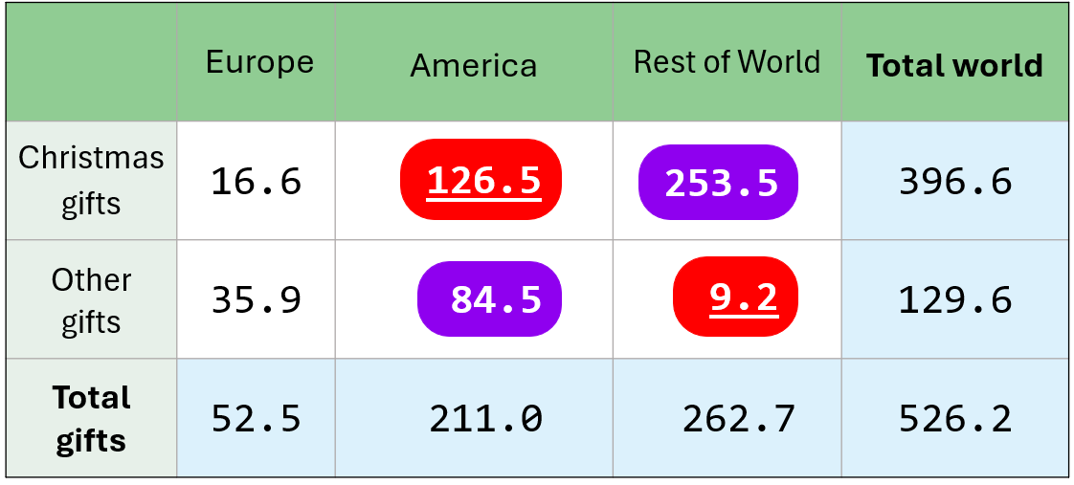
OK intervals?
One way to check:
Assume that the upper interval limit is the true cell total
Apply the dominance rules or the p% rule based on this
[117.3, 211.0]
[0.0, 93.7]

Slide 33
Intervals
[0, 2]
[117.3, 211.0]
[169.0, 262.7]
[0.0, 93.7]
[0.0, 93.7]
For the tables to be properly protected,
interval protection is needed.
But this requires heavy computations for large tables,
and it is quite common not to apply it in practice.

Slide 34
More about Perturbation

Slide 35
Perturbation – two main approaches
All cells in the output are changed independently
+ Good control over the noise added to each cell
- Additive relationships are not preserved
• Cells based on the same contributors should be perturbed identically
The underlying microdata are changed
+ Additive relationships are preserved
+ Cells based on the same contributors are automatically perturbed identically
- Difficult to control the amount of noise added to each cell
• The disclosure risk relates to the published tables, not to the microdata

Slide 36
The EZS-method (Evans, Zayatz and Slanta, 1998)
Noise is added at the microdata
Each contributor is assigned direction +1 or -1 and a noise factor
𝑝𝑒𝑟𝑡𝑢𝑟𝑏𝑒𝑑 𝑣𝑎𝑙𝑢𝑒 = 𝑜𝑟𝑖𝑔𝑖𝑛𝑎𝑙 𝑣𝑎𝑙𝑢𝑒 ∗ (1 + 𝑑𝑖𝑟𝑒𝑐𝑡𝑖𝑜𝑛 ∗ 𝑛𝑜𝑖𝑠𝑒 𝑓𝑎𝑐𝑡𝑜𝑟/100)
Thereafter a special balancing procedure for the 𝑑𝑖𝑟𝑒𝑐𝑡𝑖𝑜𝑛 component
less noise to non-sensitive cells
more noise to sensitive cells
See
Sabolová, Tepe, Adriansson and Almberg (2025)
Using perturbative methods for magnitude tables in Statistical disclosure Control,
Expert Meeting on Statistical Data Confidentiality, 15 - 17 October 2025, Barcelona Spain.
Sensitive cells similar to primary suppression

Slide 37
Cell Key Method for magnitude tables
Implemented i the cellKey R package
Along with the more common frequency table method

Slide 38
Difference cells

Slide 39
Input data
age age3 age5 count
0 0_2 [0,4] 5
1 0_2 [0,4] 7
2 0_2 [0,4] 3
3 3_5 [0,4] 0
4 3_5 [0,4] 1
5 3_5 [5,9] 2
6 6_8 [5,9] 5
7 6_8 [5,9] 4
8 6_8 [5,9] 6
9 9_11 [5,9] 0
10 9_11 [10,14] 8
11 9_11 [10,14] 4
12 12_14 [10,14] 9
13 12_14 [10,14] 3
14 12_14 [10,14] 7
Published data
age count
Total 64
0_2 15
3_5 3
6_8 15
9_11 12
12_14 19
[0,4] 16
[5,9] 17
[10,14] 31

Slide 40
Input data
age age3 age5 count
0 0_2 [0,4] 5
1 0_2 [0,4] 7
2 0_2 [0,4] 3
3 3_5 [0,4] 0
4 3_5 [0,4] 1
5 3_5 [5,9] 2
6 6_8 [5,9] 5
7 6_8 [5,9] 4
8 6_8 [5,9] 6
9 9_11 [5,9] 0
10 9_11 [10,14] 8
11 9_11 [10,14] 4
12 12_14 [10,14] 9
13 12_14 [10,14] 3
14 12_14 [10,14] 7
Sum of age = 3 and age = 4?
= [0,4] - 0_2
= 16 -15 = 1
Published data
age count
Total 64
0_2 15
3_5 3
6_8 15
9_11 12
12_14 19
[0,4] 16
[5,9] 17
[10,14] 31
Sum of age = 5 and age = 9?
= [5,9] - 6_8
= 17 -15 = 2

Slide 41
Input data
age age3 age5 count
0 0_2 [0,4] 5
1 0_2 [0,4] 7
2 0_2 [0,4] 3
3 3_5 [0,4] 0
4 3_5 [0,4] 1
5 3_5 [5,9] 2
6 6_8 [5,9] 5
7 6_8 [5,9] 4
8 6_8 [5,9] 6
9 9_11 [5,9] 0
10 9_11 [10,14] 8
11 9_11 [10,14] 4
12 12_14 [10,14] 9
13 12_14 [10,14] 3
14 12_14 [10,14] 7
Count for age = 9?
= 9_11 + 12_14 - [10,14]
= 12 + 19 - 31 = 0
or
= [0,4] + [5,9] - 0_2 - 3_5 - 6_8
= 16 + 17 – 15 – 3 - 15 = 0
Published data
age count
Total 64
0_2 15
3_5 3
6_8 15
9_11 12
12_14 19
[0,4] 16
[5,9] 17
[10,14] 31

Slide 42
Input data
age age3 age5 count
0 0_2 [0,4] 5
1 0_2 [0,4] 7
2 0_2 [0,4] 3
3 3_5 [0,4] 0
4 3_5 [0,4] 1
5 3_5 [5,9] 2
6 6_8 [5,9] 5
7 6_8 [5,9] 4
8 6_8 [5,9] 6
9 9_11 [5,9] 0
10 9_11 [10,14] 8
11 9_11 [10,14] 4
12 12_14 [10,14] 9
13 12_14 [10,14] 3
14 12_14 [10,14] 7
Count for age = 5?
= 0_2 + 3_5 - [0,4]
= 15 + 3 - 16 = 2
or
= [5,9] + [10,14] - 6_8 - 9_11 - 12_14
= 17 + 31 -15 -12 – 19 = 2
Published data
age count
Total 64
0_2 15
3_5 3
6_8 15
9_11 12
12_14 19
[0,4] 16
[5,9] 17
[10,14] 31

Slide 43
Difference cells
[5,9] - 6_8
9_11 + 12_14 - [10,14]
[0,4] + [5,9] - 0_2 - 3_5 - 6_8
[0,4] - 0_2
Finding and protecting all sensitive cells in the published tables is not always sufficient
Difference cells can be derived, and some of them may themselves be sensitive
We have seen this in frequency tables, and the same issue arises in magnitude tables

Slide 44
Difference cells
[5,9] - 6_8
9_11 + 12_14 - [10,14]
[0,4] + [5,9] - 0_2 - 3_5 - 6_8
[0,4] - 0_2
Particularly challenging when using suppression
Also important to consider when applying perturbation methods

Slide 45
Tabular data protection methods
Disclosure risk can be avoided by
using coarser categories
e.g. by counties instead of municipalities
by suppression (hiding values)
or by perturbation (changing values)
In addition to the methods we have discussed, tables can also be constructed in different ways.

Slide 46
Takk!

